Slide 1
Unsupervised Learning: Deep Auto-encoder
Notes:
http://www.deeplearningbook.org/contents/autoencoders.html
Output
- idea of compressions
-audoencoder
- application
retrieval
image
-also as initilization

Slide 2

Auto-encoder
Usually <784
Compact representation of the input object
NN
Encoder
code
28 X 28 = 784
Learn together
NN
Decoder
Can reconstruct the original object
code

Slide 3







Starting from PCA
Minimize
$${\left(x−\hat{x} \right)}^{2}$$
As close as possible
encode
decode
$$x$$
$$c$$
$$\hat{x}$$
$$W$$
$$W^{T}$$
hidden layer
(linear)
Input layer
output layer
Bottleneck later
Output of the hidden layer is the code
Notes:
A neutral net whose output tries to reconstruct the input
Target of output ($\hat{y}$) = input ($x$)

Slide 4






Deep Auto-encoder
Symmetric is not necessary.
Of course, the auto-encoder can be deep
As close as possible
…
…
Layer
Layer
Output Layer
Input Layer
Layer
bottle
Layer
Layer
Layer
$$W_{2}^{T}$$
$$W_{1}$$
$$W_{2}$$
$$W_{1}^{T}$$
Initialize by RBM layer-by-layer
$$x$$
Code
$$\hat{x}$$
Reference: Hinton, Geoffrey E., and Ruslan R. Salakhutdinov. "Reducing the dimensionality of data with neural networks." Science 313.5786 (2006): 504-507
Notes:
codes

Slide 5




Deep Auto-encoder
Original Image
784
30
784
PCA
Deep
Auto-encoder
784
1000
500
250
30
250
500
784
1000
Notes:
Hand-written digits
Deep auto-encoder has better reconstruction capability

Slide 6
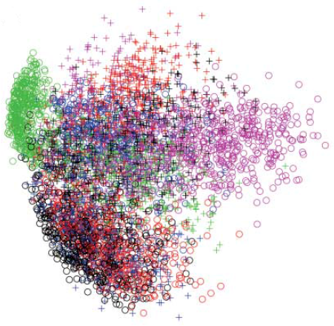
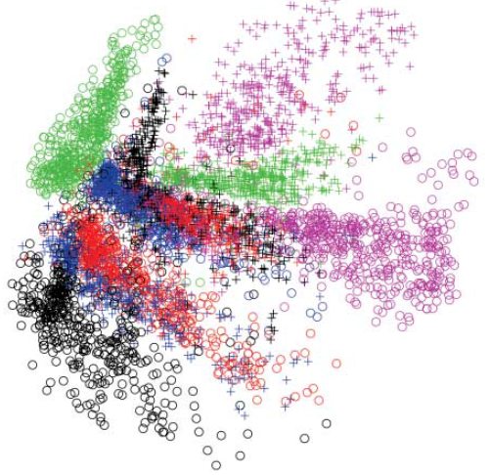
784
2
784
784
1000
500
250
2
250
500
784
1000
Notes:
From 30 to 2

Slide 7
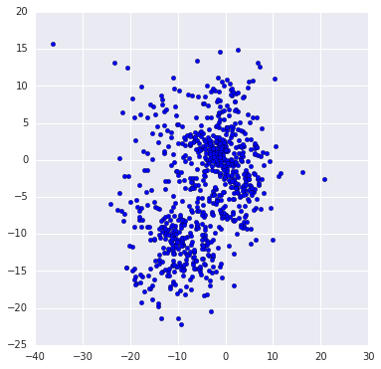
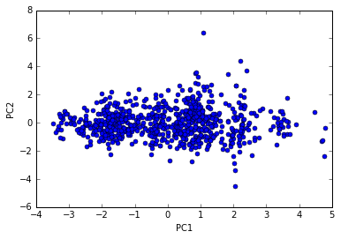
Pokémon
http://140.112.21.35:2880/~tlkagk/pokemon/pca.html
http://140.112.21.35:2880/~tlkagk/pokemon/auto.html
The code is modified from
http://jkunst.com/r/pokemon-visualize-em-all/

Slide 8
Auto-encoder – Text Retrieval
Vector Space Model
Bag-of-word
this
1
is
1
word string:
“This is an apple”
query
a
0
an
1
…
apple
1
pen
0
document
Semantics are not considered.
Notes:
idf

Slide 9
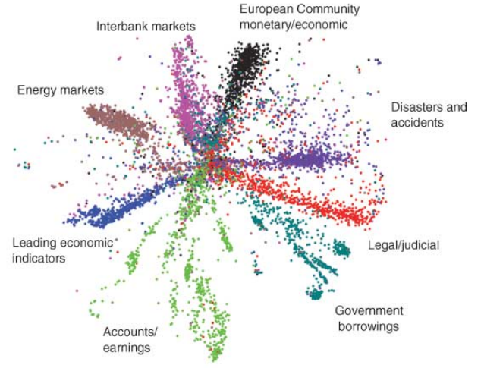
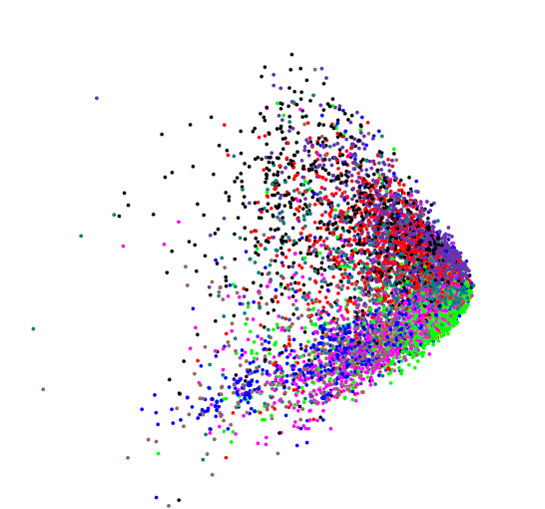
Auto-encoder – Text Retrieval
The documents talking about the same thing will have close code.
2
query
125
250
500
2000
LSA: project documents to 2 latent topics
Bag-of-word
(document or query)
Notes:
The qeruy not always have the common word

Slide 10
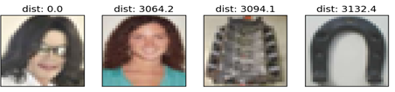
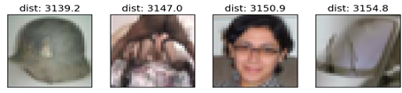
Auto-encoder – Similar Image Search
Retrieved using Euclidean distance in pixel intensity space
(Images from Hinton’s slides on Coursera)
Reference: Krizhevsky, Alex, and Geoffrey E. Hinton. "Using very deep autoencoders for content-based image retrieval." ESANN. 2011.
Notes:
Direct compute on pixel label is slow!

Slide 11

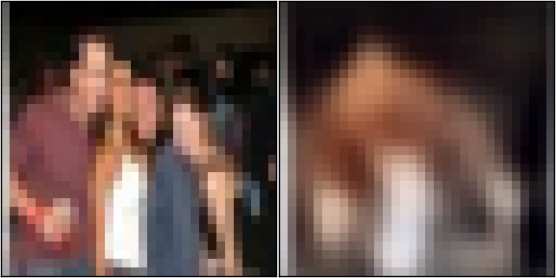


Auto-encoder – Similar Image Search
code
8192
2048
1024
512
256
4096
32x32
(crawl millions of images from the Internet)
Notes:
Reconstructions of 32x32 color images from 256-bit codes

Slide 12
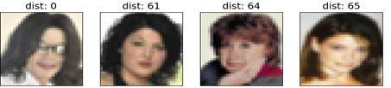
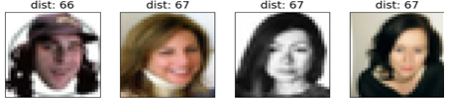
Retrieved using Euclidean distance in pixel intensity space
retrieved using 256 codes
Notes:
faster

Slide 13


Auto-encoder – Pre-training DNN
Greedy Layer-wise Pre-training again
output
10
500
Target
1000
784
$$\hat{x}$$
W¹’
1000
1000
W¹
Input
784
Input
784
$$x$$

Slide 14



Auto-encoder – Pre-training DNN
Greedy Layer-wise Pre-training again
output
10
500
1000
$${\hat{a}}^{1}$$
W²’
Target
1000
1000
W²
1000
1000
$$a^{1}$$
fix
W¹
Input
784
Input
784
$$x$$

Slide 15


Auto-encoder – Pre-training DNN
Greedy Layer-wise Pre-training again
output
$${\hat{a}}^{2}$$
10
1000
W³’
500
500
W³
Target
$$a^{2}$$
1000
1000
fix
W²
1000
1000
$$a^{1}$$
fix
W¹
Input
784
Input
784
$$x$$

Slide 16
Auto-encoder – Pre-training DNN
Find-tune by backpropagation
Greedy Layer-wise Pre-training again
output
output
10
10
Random init
W⁴
500
500
W³
Target
1000
1000
W²
1000
1000
W¹
Input
784
Input
784
$$x$$

Slide 17





Auto-encoder
More: Contractive auto-encoder
Ref: Rifai, Salah, et al. "Contractive auto-encoders: Explicit invariance during feature extraction.“ Proceedings of the 28th International Conference on Machine Learning (ICML-11). 2011.
De-noising auto-encoder
As close as possible
encode
decode
$$c$$
$$x$$
$$x′$$
$$\hat{x}$$
Add noise
Vincent, Pascal, et al. "Extracting and composing robust features with denoising autoencoders." ICML, 2008.
Notes:
有收縮性的

Slide 18
Learning More - Restricted Boltzmann Machine
Neural networks [5.1] : Restricted Boltzmann machine – definition
https://www.youtube.com/watch?v=p4Vh_zMw-HQ&index=36&list=PL6Xpj9I5qXYEcOhn7TqghAJ6NAPrNmUBH
Neural networks [5.2] : Restricted Boltzmann machine – inference
https://www.youtube.com/watch?v=lekCh_i32iE&list=PL6Xpj9I5qXYEcOhn7TqghAJ6NAPrNmUBH&index=37
Neural networks [5.3] : Restricted Boltzmann machine - free energy
https://www.youtube.com/watch?v=e0Ts_7Y6hZU&list=PL6Xpj9I5qXYEcOhn7TqghAJ6NAPrNmUBH&index=38

Slide 19
Learning More - Deep Belief Network
Neural networks [7.7] : Deep learning - deep belief network
https://www.youtube.com/watch?v=vkb6AWYXZ5I&list=PL6Xpj9I5qXYEcOhn7TqghAJ6NAPrNmUBH&index=57
Neural networks [7.8] : Deep learning - variational bound
https://www.youtube.com/watch?v=pStDscJh2Wo&list=PL6Xpj9I5qXYEcOhn7TqghAJ6NAPrNmUBH&index=58
Neural networks [7.9] : Deep learning - DBN pre-training
https://www.youtube.com/watch?v=35MUlYCColk&list=PL6Xpj9I5qXYEcOhn7TqghAJ6NAPrNmUBH&index=59
Notes:
$≠$DNN

Slide 20
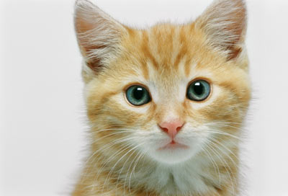
Auto-encoder for CNN
As close as possible
Deconvolution
Convolution
Unpooling
Pooling
Deconvolution
Convolution
Unpooling
Pooling

Slide 21
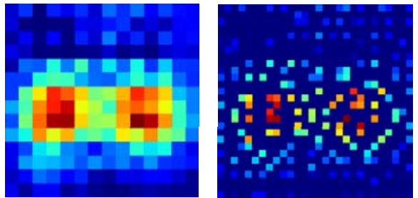
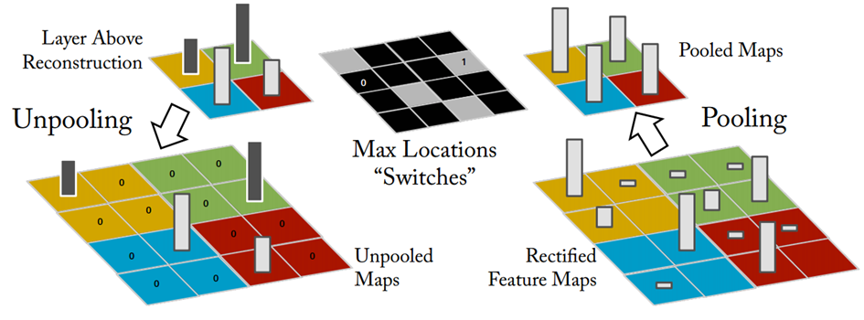
CNN -Unpooling
14 x 14
28 x 28
Alternative: simply repeat the values
Source of image : https://leonardoaraujosantos.gitbooks.io/artificial-inteligence/content/image_segmentation.html

Slide 22
CNN - Deconvolution
Actually, deconvolution is convolution.
+
+
+
=
+

Slide 23
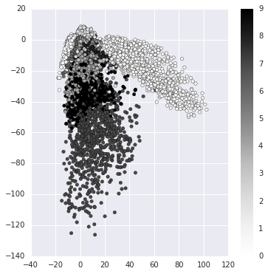
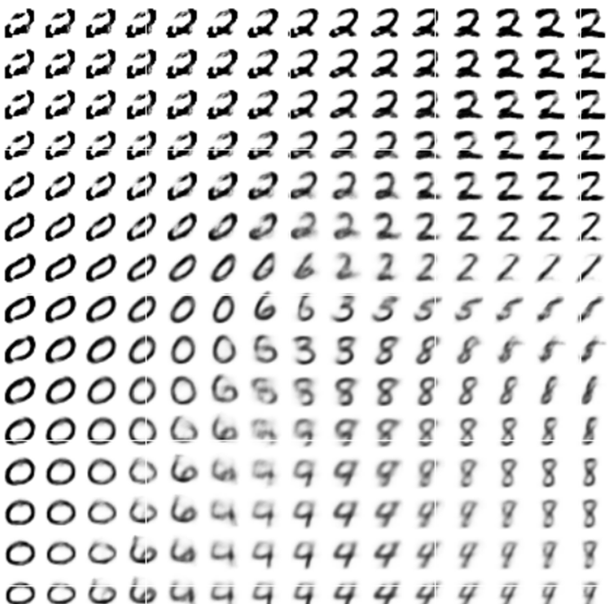
Next …..
NN
Decoder
code
Can we use decoder to generate something?
Notes:
SOM: http://alaric-research.blogspot.tw/2011/02/self-organizing-map.html

Slide 24
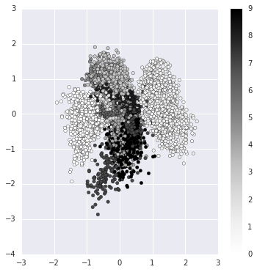
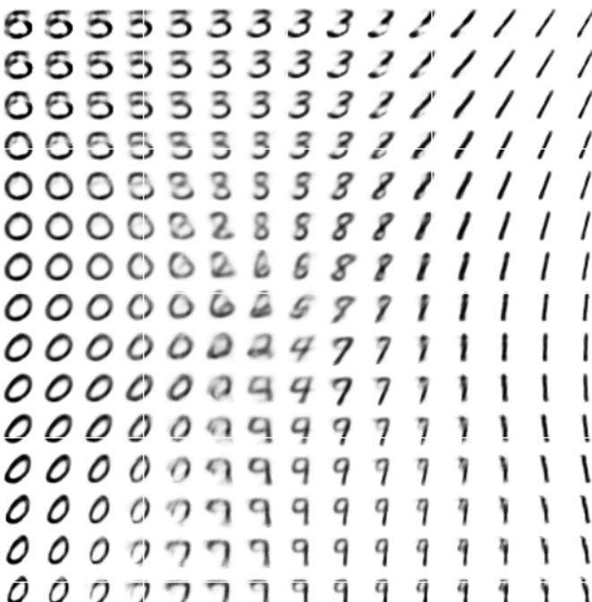
Next …..
NN
Decoder
code
Can we use decoder to generate something?
Notes:
SOM: http://alaric-research.blogspot.tw/2011/02/self-organizing-map.html

